Slide 1
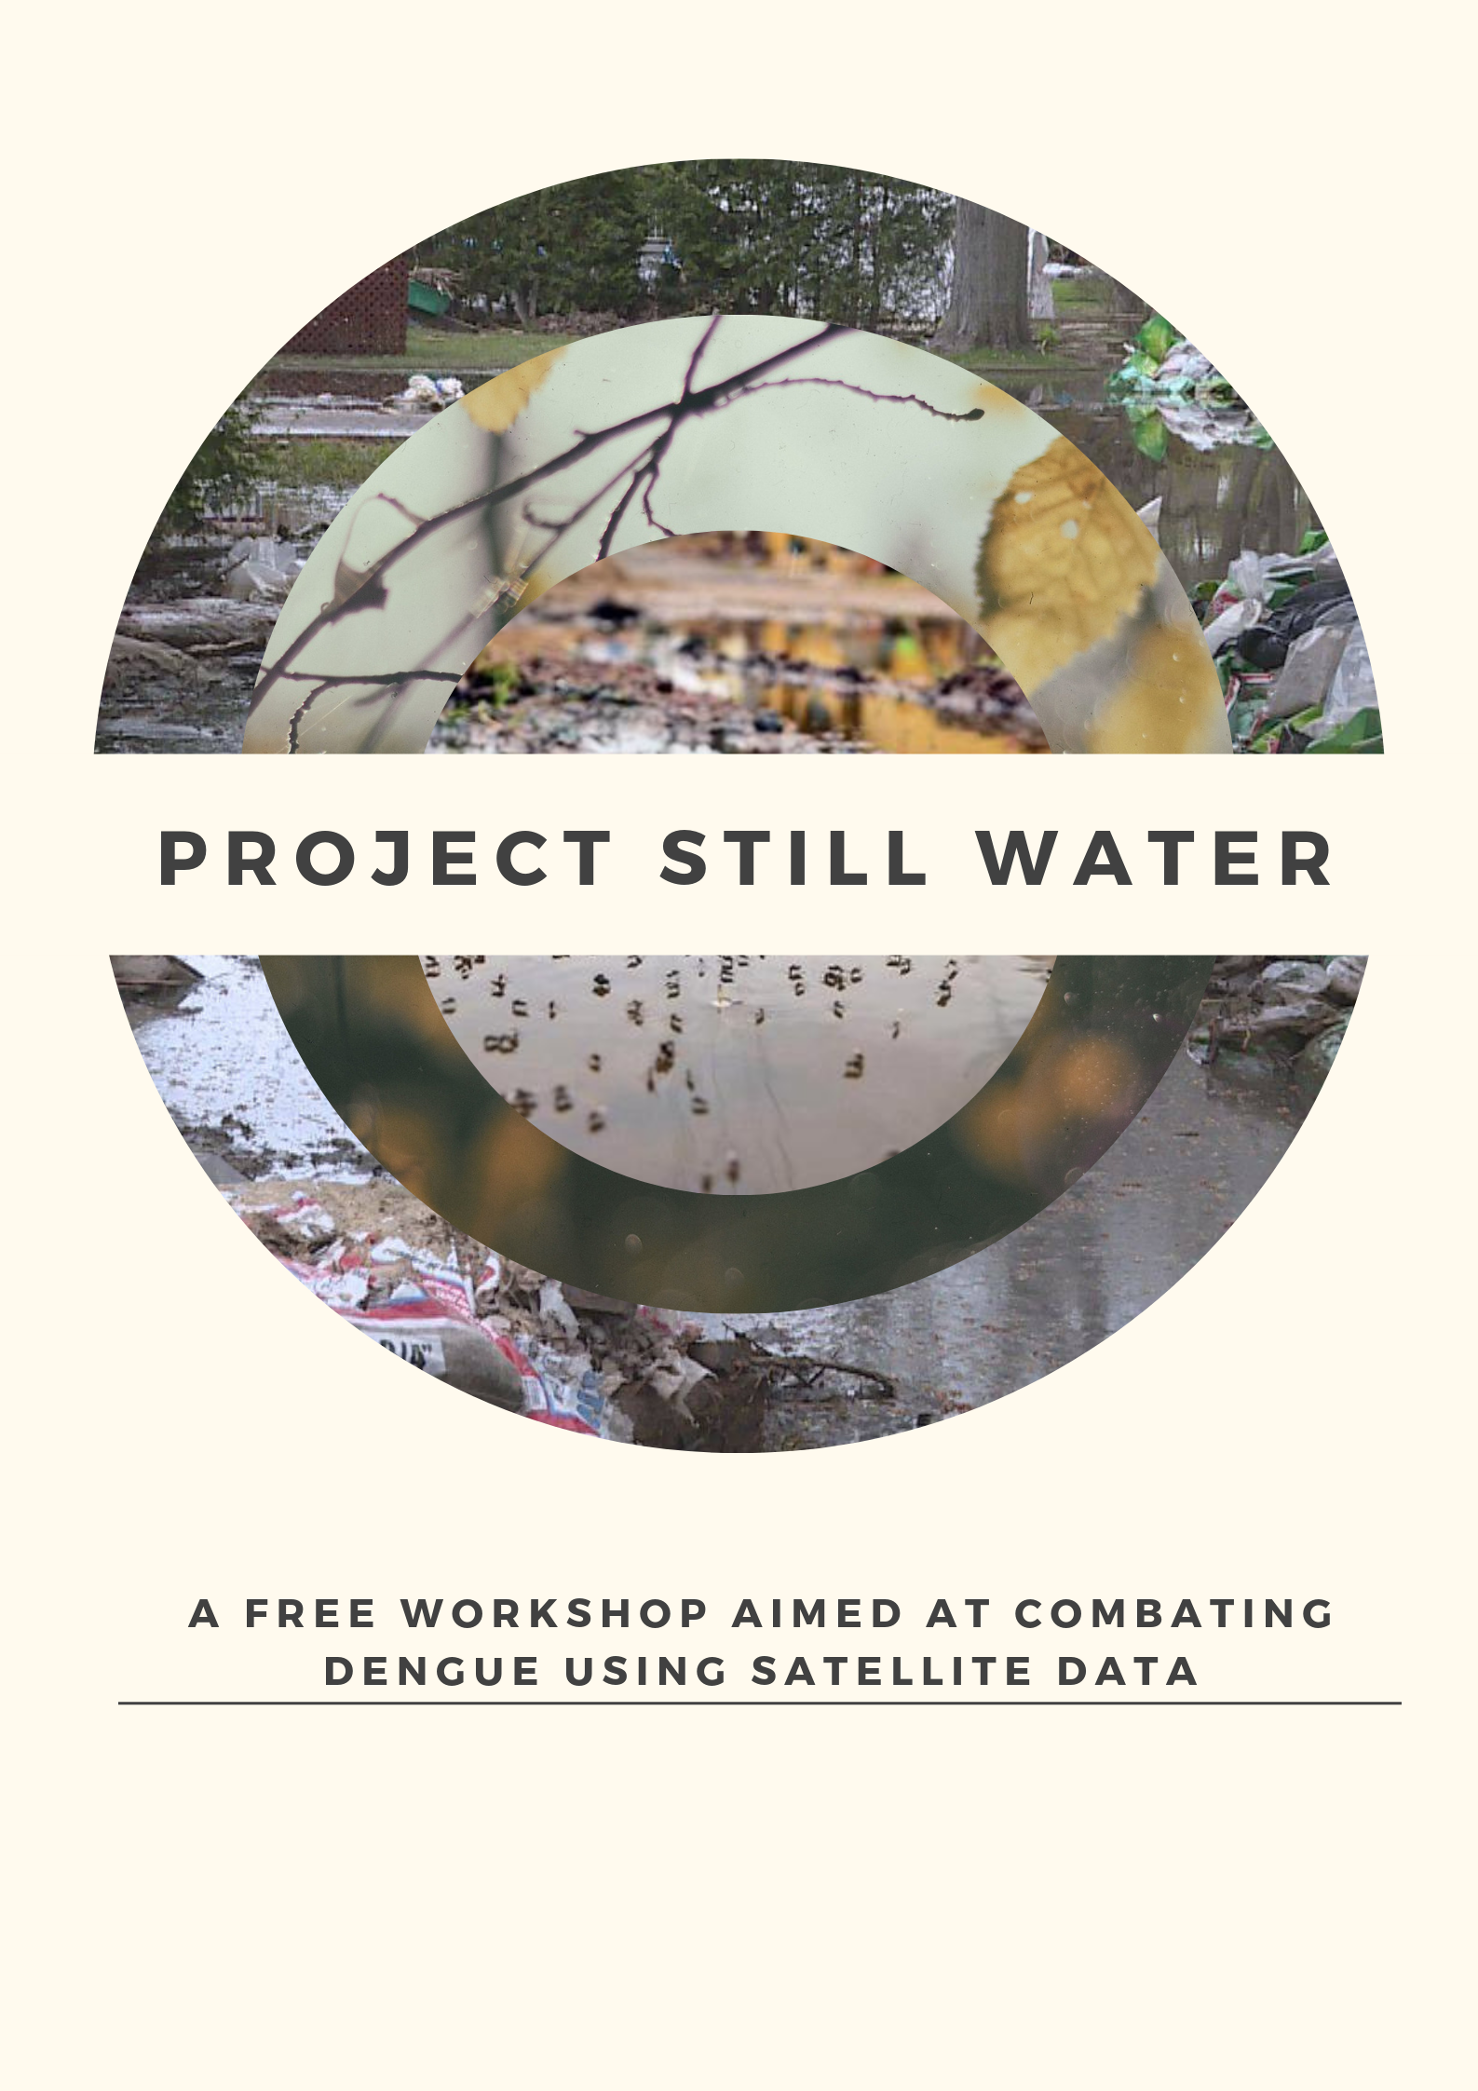

Slide 2


















Our Partners/supporters
Notes:
QGIS also supports MAC
Globe supplied us with 20 cps

Slide 3
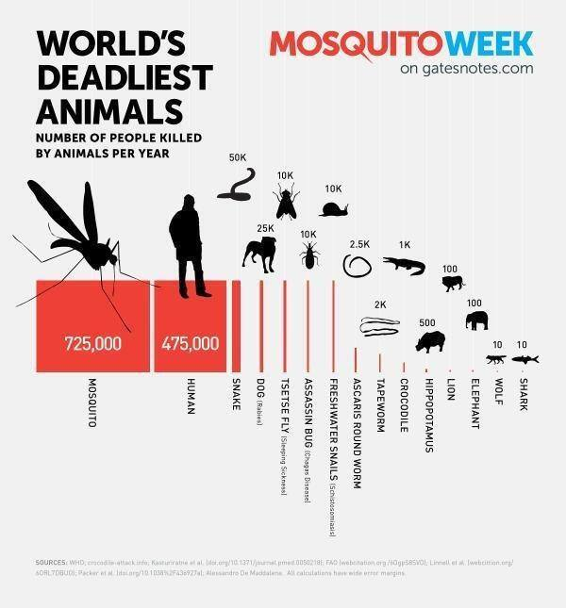

Hows and Why Do This?

Slide 4
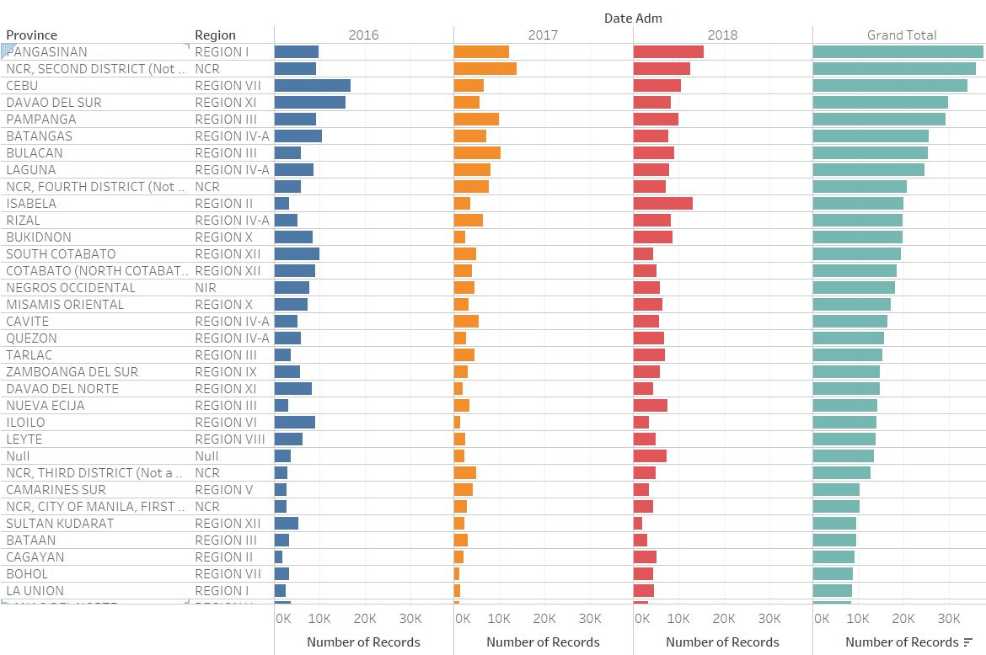

Slide 5
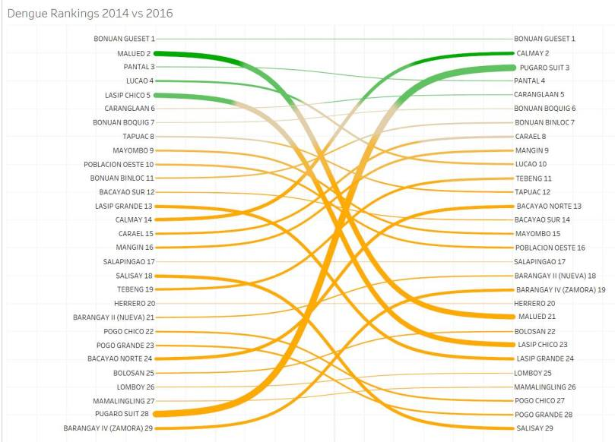

Slide 6
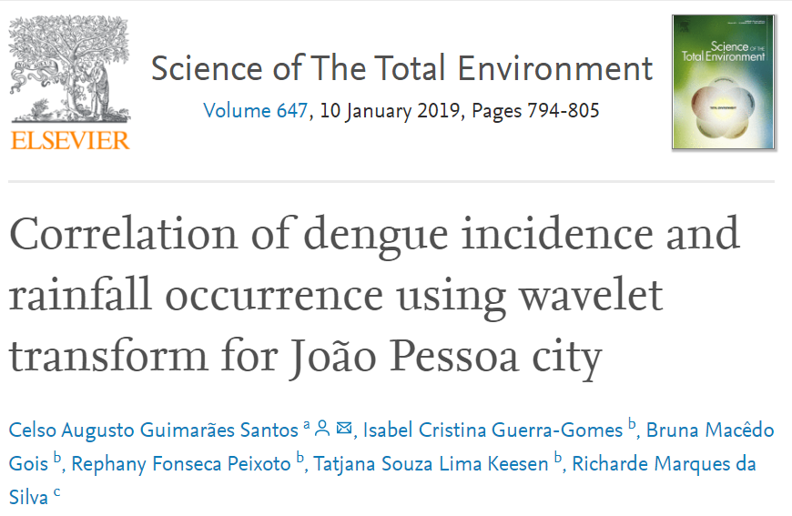
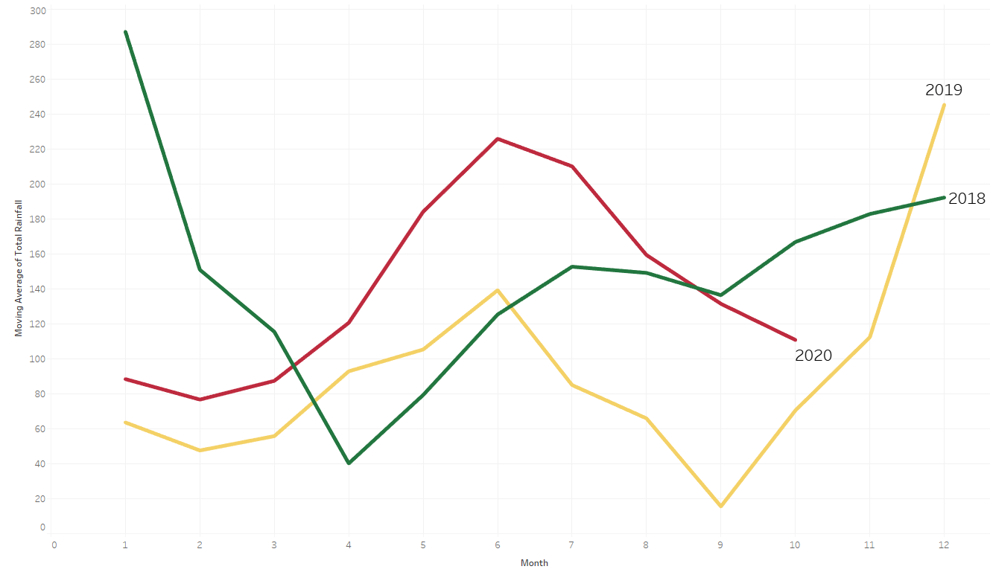
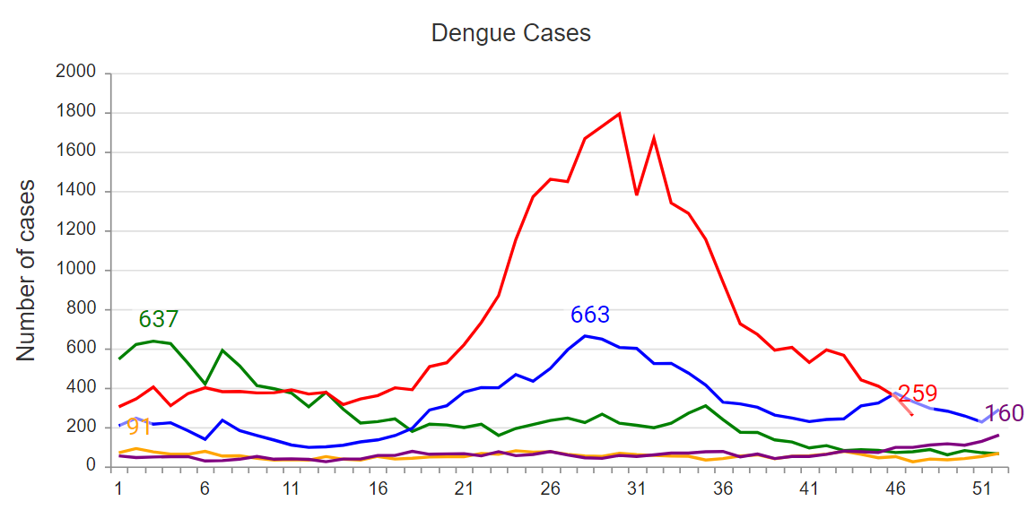
Rainfall and Dengue in Singapore

Slide 7
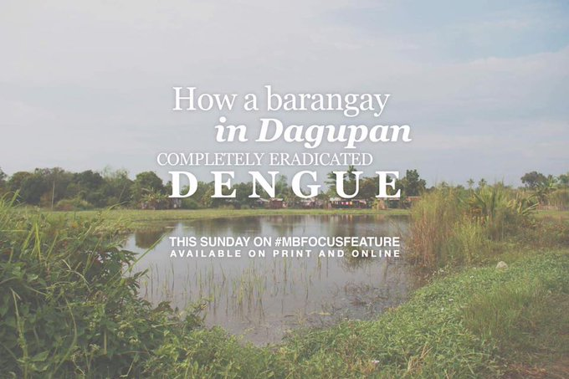

Slide 8
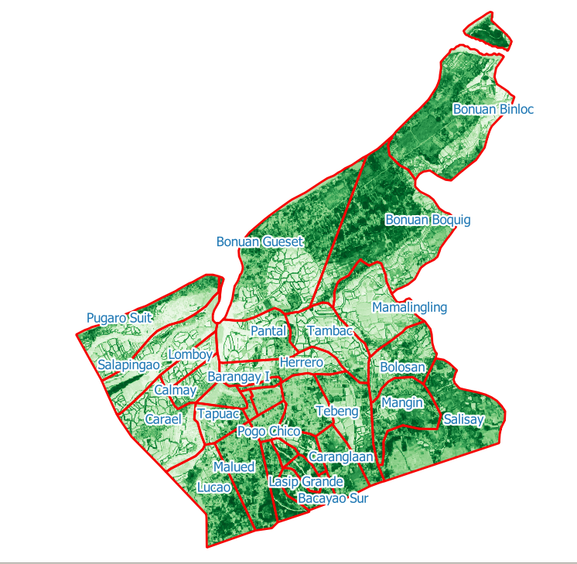
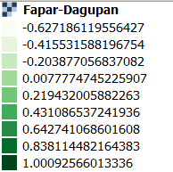
FAPAR (Vegetation) Map

Slide 9
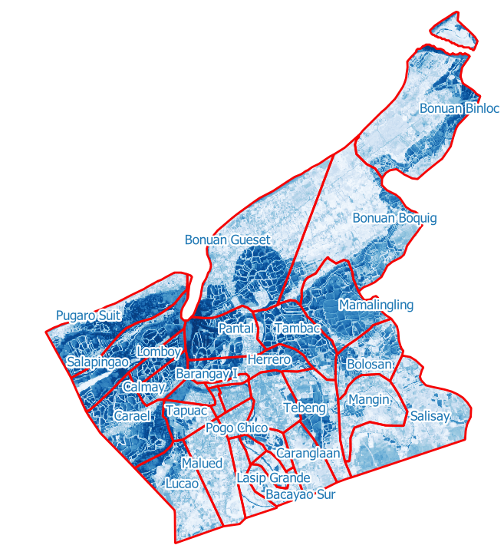
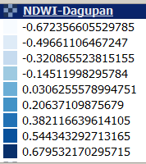
NDWI Water Map

Slide 10
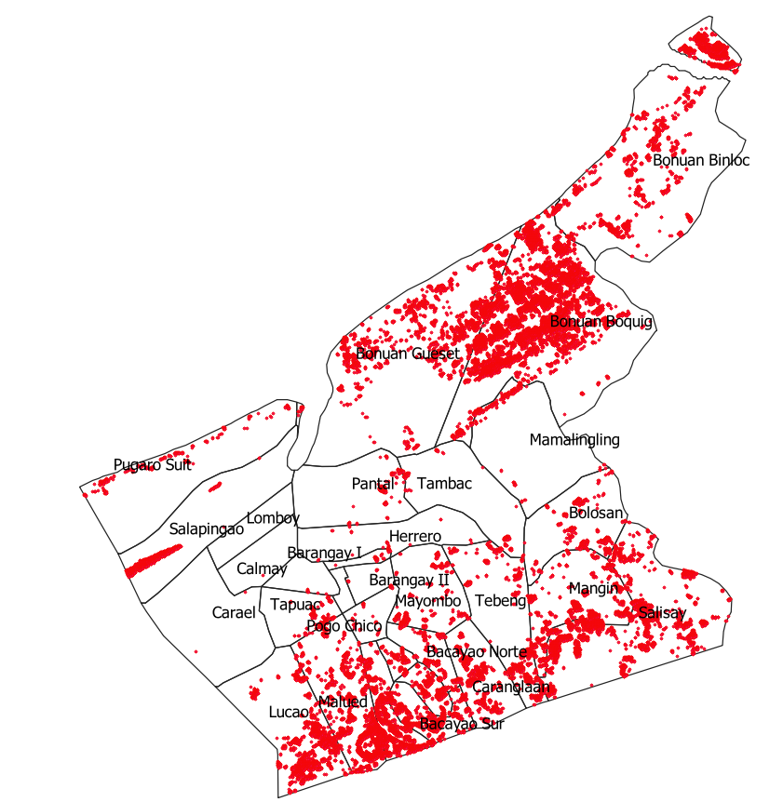
Stagnant Waters
Displaying the Map

Slide 11
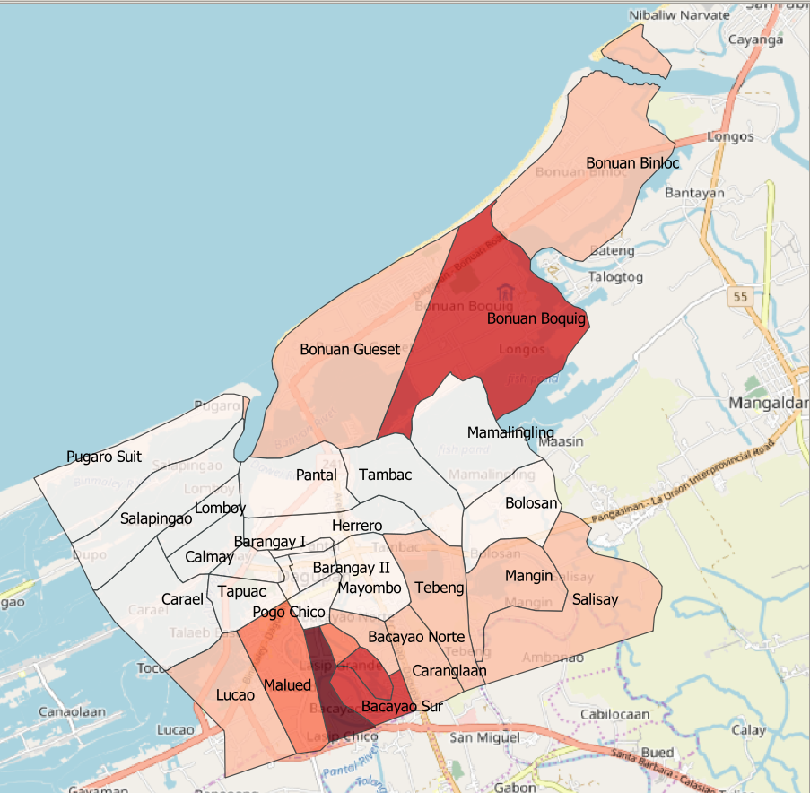
4. Prediction
Stagnant Water density ratio to Land Area correctly predicted the spike in dengue a few weeks later.

Slide 12
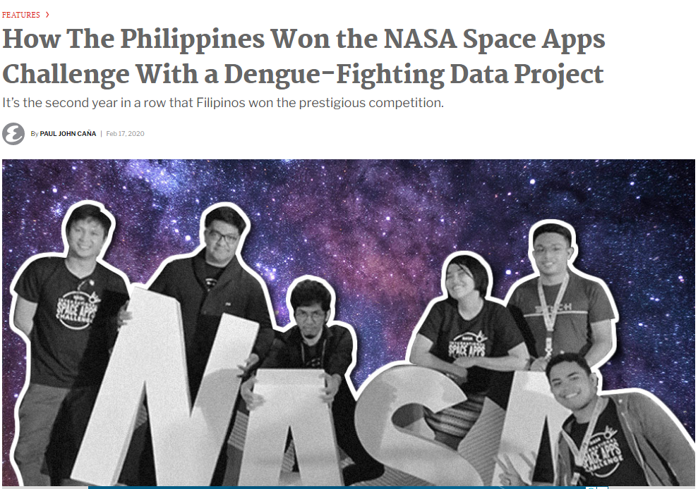

Slide 13
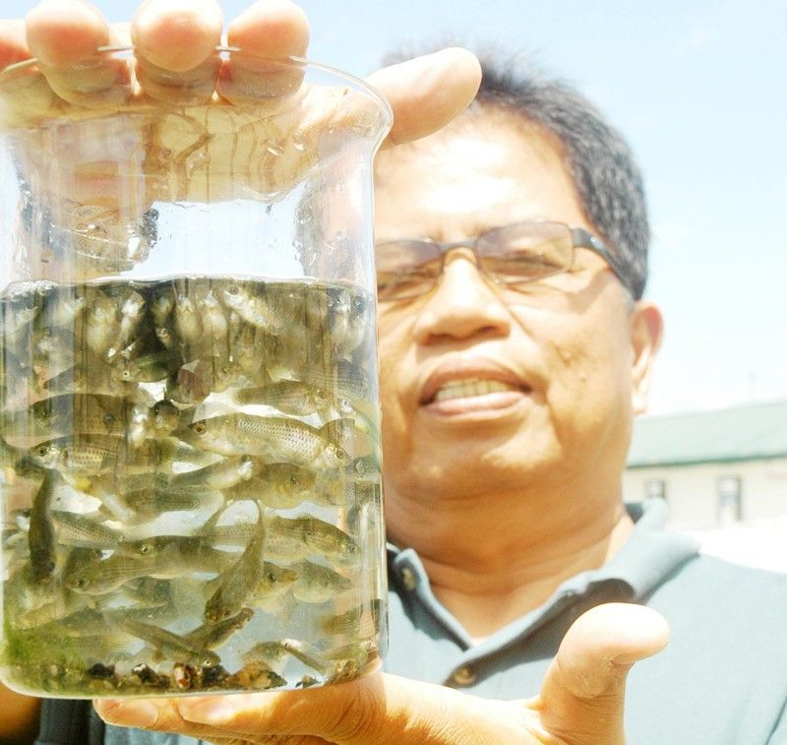
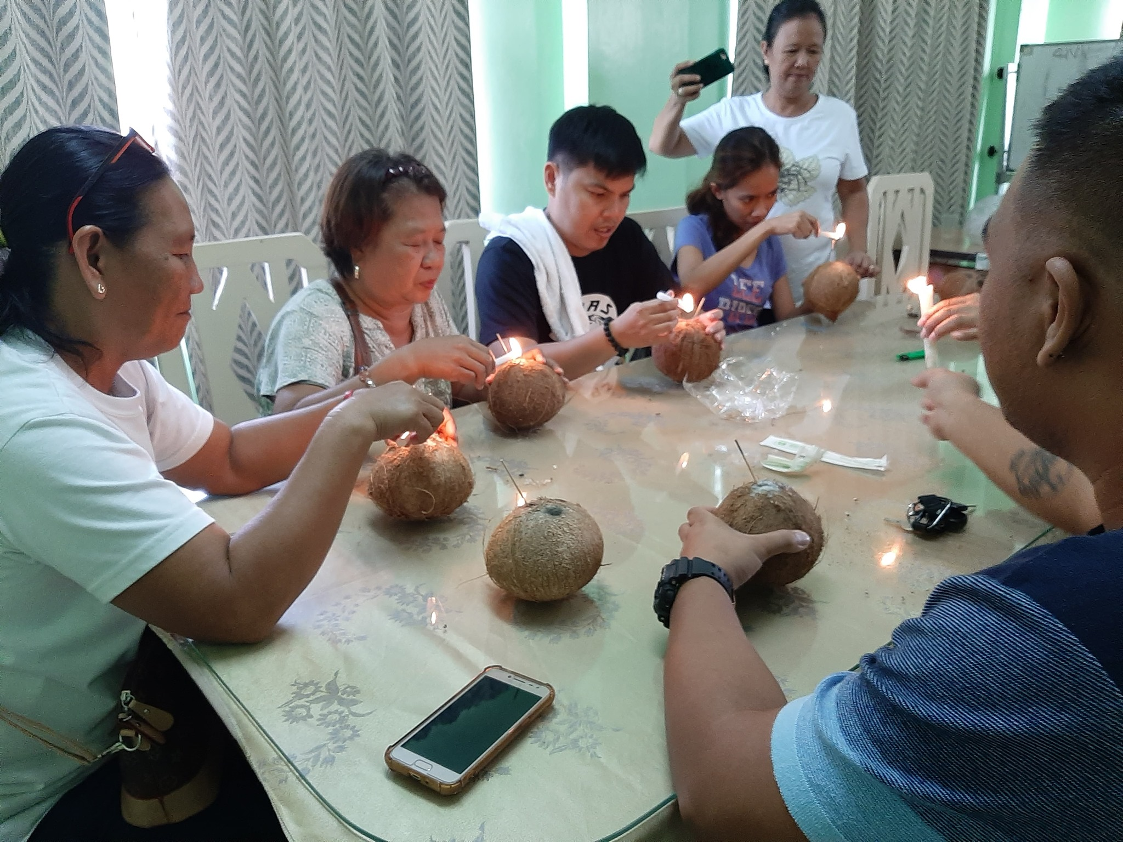
Biological controls
Dr Wesley Rosario, BFAR and mosquito fish that were released to control mosquito larvae
Dagupan’s Brgy Captains in Workshop to learn how to create BTI Coconut Bombs
Biological control using Gambisia Affinis (mosquito fish)
Biological control using Bacillus Thuringiensis Israelensis cultured inside Coconuts
Notes:
From the 1920s to the 1950s, mosquitofish were a major factor in eradicating malaria in South America, southern Russia, and Ukraine. A somewhat famous example of mosquitofish eradicating malaria is on the coast of the Black Sea near Sochi in Russia.^{[18][22][23]} In Sochi, the mosquitofish is commemorated for eradicating malaria by a monument of the fish.^{[24][25]} In 2008, in some parts of California and in Clark County, Nevada, mosquitofish were bred in aquariums so people could stock stagnant pools of water with the mosquitofish to reduce the number of West Nile virus cases.

Slide 14

Share your Visualization with us
We would love to know about how you have taken this methodology forward and how it has helped your community.
Do drop us a note with your visuals and send over a copy of your CSV exports. We will add them to our growing dataset for future project by data scientist.

Slide 15
Pay it Forward. Share this with others.
Or join us on Facebook https://www.facebook.com/groups/1805237739779109

Slide 16

In Memory of: Benjamin Tan

